Slide 1
2026 INCITE Proposal Writing Webinar
Our presentation will begin at 2:00 pm EDT / 1:00 pm CDT
A few reminders:
Please ensure your camera and microphone are both turned off.
During the presentation, questions will be taken in the chat window. There will be a time for verbal questions near the end. You can temporarily unmute yourself either by pressing and holding the space bar while you speak.
These slides and eventually a recording of this presentation can be downloaded from
https://www.doeleadershipcomputing.org/proposal/informational-webinars/
Notes:
Have this up starting 15min before the webinar

Slide 2
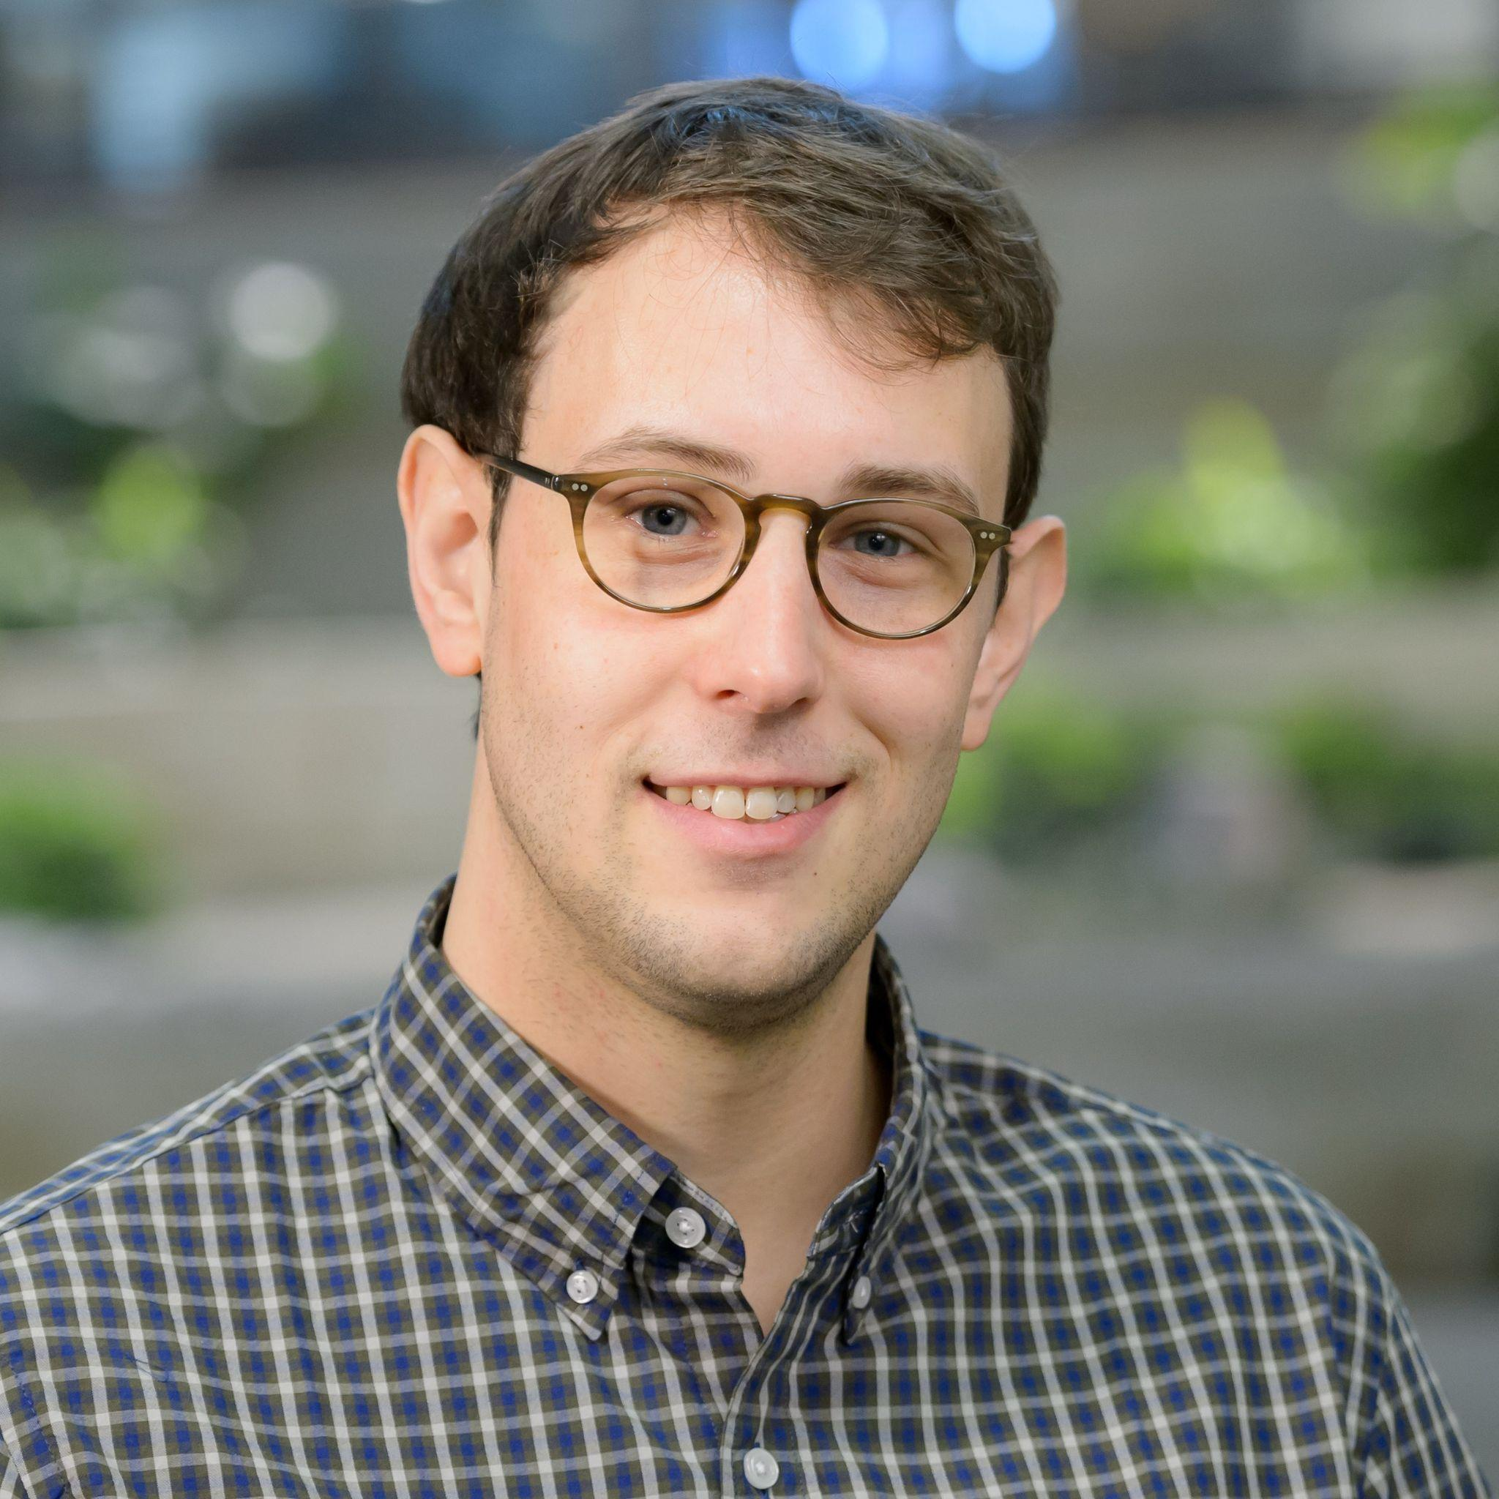
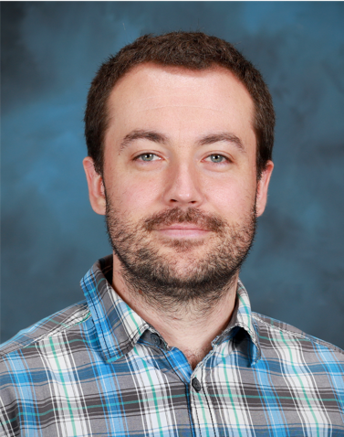
2026 INCITE Proposal Writing Webinar
Kyle Felker
ALCF Catalyst
Argonne National Laboratory
Katherine Riley
INCITE Program Manager
Dmytro Bykov
OLCF Scientific Engagement Section
Oak Ridge National Laboratory

Slide 3
Objectives of INCITE Proposal Writing Webinar
Learn to write a proposal to obtain significant allocations of compute time and resources at DOE’s Leadership Computing Facilities
Describe proposal sections, content, and tips for new and renewal authors.
Proposal narratives consist of up to 15 pages describing
Description of high-impact science challenge
Description of methods, codes, and dependencies
Demonstration that computational tasks cannot be done anywhere else
Description of team qualifications
Timeline
New Proposals are due June 16, 2025
Renewal Proposals are due July 21, 2025 (only those awarded multi-year proposals)
PIs will be notified in November 2025
Awards begin on January 1, 2026

Slide 4
New and Renewal Proposals
New
Renewal
Eligibility
PI without current active proposal
PI with current active proposal in Year 1, 2 or 3 to end in 2025
PI with current active proposal and not eligible for renewal
Deadline
June 16, 2025
Eligibility
PI with current active proposal in Year 1 or 2 and eligible^{(*)} to submit a renewal proposal
^{(*)} PI will receive a notification from INCITE Program Manager with approval to submit a renewal.
Deadline
July 21, 2025

Slide 5
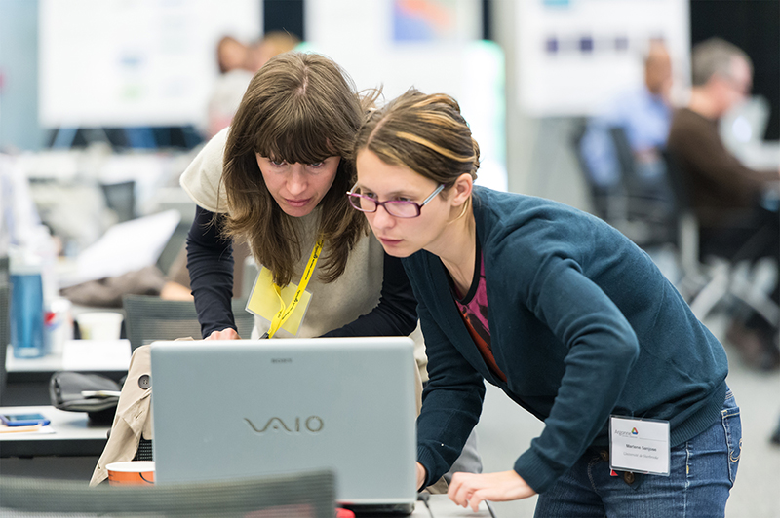
Today’s Agenda
Allocation programs [9]
INCITE mission and recent stats [10 – 23]
LCF computing systems [24 –32]
Tips for applicants [33 – 54]
Common oversights
Requesting a startup account
Benchmarking data
Q&A [55, open discussion]
Conclusions [56 – 62]
Submittal, review, and awards decisions
Contact links

Slide 6
Changes to the Program / Proposal Submission
Polaris staying available for 2026
From last year
Short paragraph for potential public use
If awarded INCITE, this paragraph is used as a first draft for factsheets
Proposal Development Support
https://www.doeleadershipcomputing.org/proposal/proposal-development-support/
A reminder:
All submission materials must be concatenated together into a single PDF file for submission. Individual files will not be permitted.

Slide 7
Changes to the Program / Proposal Submission
Special requests
Does your project require specialized services such as streaming, near-real time, real time, on-demand, etc?
New question for PIs to identify those projects that may require resources or services that may not be commonly used on the systems.
Training Opportunities
Are you aware that ALCF and OLCF offer a variety of training opportunities on their systems? These opportunities include webinars, in-person workshops, hack-a-thons (in-person and remote), etc. If 'Yes', please list any events you or your team have attended.
Help us improve our training by indicating which events you (or your team) have attended and if they were useful

Slide 8
Changes to the Program / New Testbeds
The ALCF and OLCF have testbed resources for new technologies, details below. If you would like access to these resources to support the work in this proposal, please provide the following information. Describe the experiments you would be interested in performing, resources required, and their relationship to the current proposal. Please note, these are smaller experimental resources and a large amount of resources is not available. Instead, these resources are to explore the possibilities for how these technologies might innovate future work.
The ALCF AI Testbed
https://www.alcf.anl.gov/alcf-ai-testbed
OLCF Quantum Computing User Program
https://www.olcf.ornl.gov/olcf-resources/compute-systems/quantum-computing-user-program

Slide 9
Resources Available for INCITE 2026
ALCF Polaris system is a hybrid CPU/GPU machine that will be available to 2026 INCITE projects. Polaris is open for 1-year proposals.
OLCF Frontier is an exascale hybrid CPU/GPU machine that will be available to 2026 INCITE projects. Frontier is open for 3-year proposals.
ALCF Aurora is an exascale hybrid CPU/GPU machine that will be available to 2026 INCITE projects. Aurora is open for 3-year proposals.

Slide 10
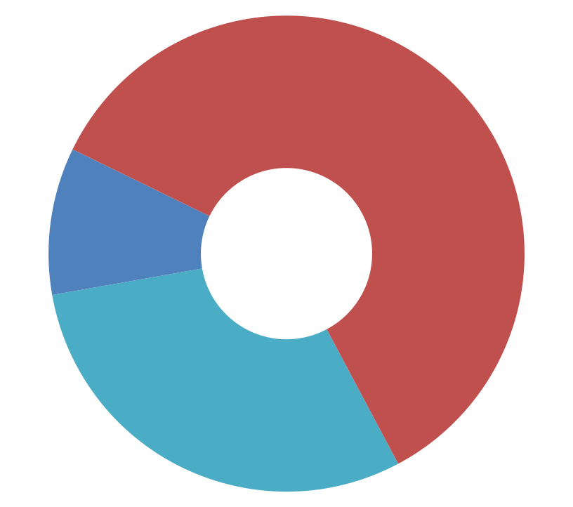
Primary ways to gain access to LCF Current distribution of allocable hours
Up to 60% INCITE
10% Director’s Discretionary
(Includes LCF strategic programs)
Leadership-class computing
30% ASCR Leadership Computing Challenge & ECP
DOE/SC capability computing

Slide 11
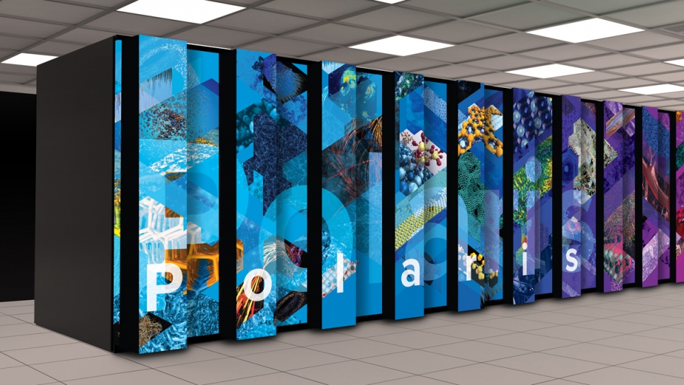
What is INCITE?
Innovative and Novel Computational Impact on Theory and Experiment
INCITE promotes transformational advances in science and technology through large allocations of computer time, supporting resources, and data storage at the Argonne and Oak Ridge Leadership Computing Facilities (LCFs) for compute intensive and/or data intensive large-scale research projects.

Slide 12
INCITE Seeks High-impact Research Campaigns
Examples of previous successful INCITE applications that advance the state-of-the- art across a broad range of topics and different mission priorities
Astro-
Physics
Biology
Glimpse into dark matter
Supernovae ignition
Protein structure
Creation of biofuels
Replicating enzyme functions
Membrane channels
Protein folding
Chemistry
Chemical catalyst design
Batteries
Solar Cells
Engineering
Additional
topic areas
Turbulent flow
Propulsor systems
Nanodevices
Data and AI
Computer Science
Plasma Physics
Fusion Research
Quantum Physics
Materials Science/Engineering
Nuclear
Earth
Sciences
Global climate
Carbon sequestration
Seismology

Slide 13
INCITE Criteria Access on a competitive, merit-reviewed basis*
1 | Merit criterion
 | Research campaign with the potential for significant domain and/or community impact
2 | Computational leadership criterion
 | Computationally demanding and/or data intensive runs that cannot be done anywhere else: capability, architectural needs, data and AI at scale
3 | Eligibility criterion
 | Grant allocations regardless of funding source Non-US-based researchers are welcome to apply
*DOE High-End Computing Revitalization Act of 2004: Public Law 108-423

Slide 14
Twofold review process
 | New proposal assessment | Renewal assessment
Peer review: INCITE science panels + (when appropriate) Data/AI panel | Scientific and/or technical merit Appropriateness of proposal method, milestones given Team qualifications Reasonableness of requested resources | Scientific and/or technical merit Met milestones Change in scope On track to meet future milestones
Technical assessment: LCF centers | Technical readiness Appropriateness for requested resources | Met technical/ computational milestones On track to meet future milestones
Award Decisions | INCITE Awards Committee comprised of LCF directors, INCITE program manager, LCF directors of science, senior management

Slide 15
Some limitations on what can be done
Federal law regulates what can be done on these systems
LCF systems have cyber security plans that bound the types of data that can be used and stored on them
Some kinds of information we cannot have
Personally Identifiable Information (PII)
Classified Information or National Security Information
Unclassified Controlled Nuclear Information (UCNI)
Naval Nuclear Propulsion Information (NNPI)
Information about development of nuclear, biological or chemical weapons, or weapons of mass destruction

Slide 16
Proprietary Work
TIP
Do not include proprietary and/or export controlled information in the proposal, whether or not the project itself is nonproprietary.
Proprietary use (e.g., using the resources to generate data or results that they wish to designate as proprietary) of the HPC resources is allowed and will include full cost recovery through a proprietary user agreement. The use of proprietary or export-controlled software applications or input data does not by itself constitute proprietary use of the facility. A single and standardized peer-review selection process and project reporting requirement, as described within the INCITE Overview and Policies, will be implemented for both proprietary and non-proprietary user proposals. Given the complexities associated with proprietary research, individuals considering submittal of a proposal for proprietary research must contact the INCITE manager, INCITE@DOEleadershipcomputing.org, before the call for proposals closes to discuss the policy on proprietary work.
[Reference: INCITE Overview and Policies. See http://www.doeleadershipcomputing.org/proposal/call-for-proposals/]

Slide 17
Community vs. Umbrella Proposals
The program encourages community proposals that reflect community consensus on, and participation in pursuing, a particular investigative strategy for addressing a grand-challenge-scale science problem. This consensus should be in large part reflected in the proposal’s management plan, which describes how the problem will be tackled and the interrelationship of the activities of each of the proposal team investigators.
The program does not encourage umbrella proposals, which is defined to be a collection of individual proposals aimed at various aspects of a particular science problem but with no clearly articulated interrelationship of the activities of each of the proposal team investigators and/or that do not exploit the unique capabilities of the leadership facilities.

Slide 18
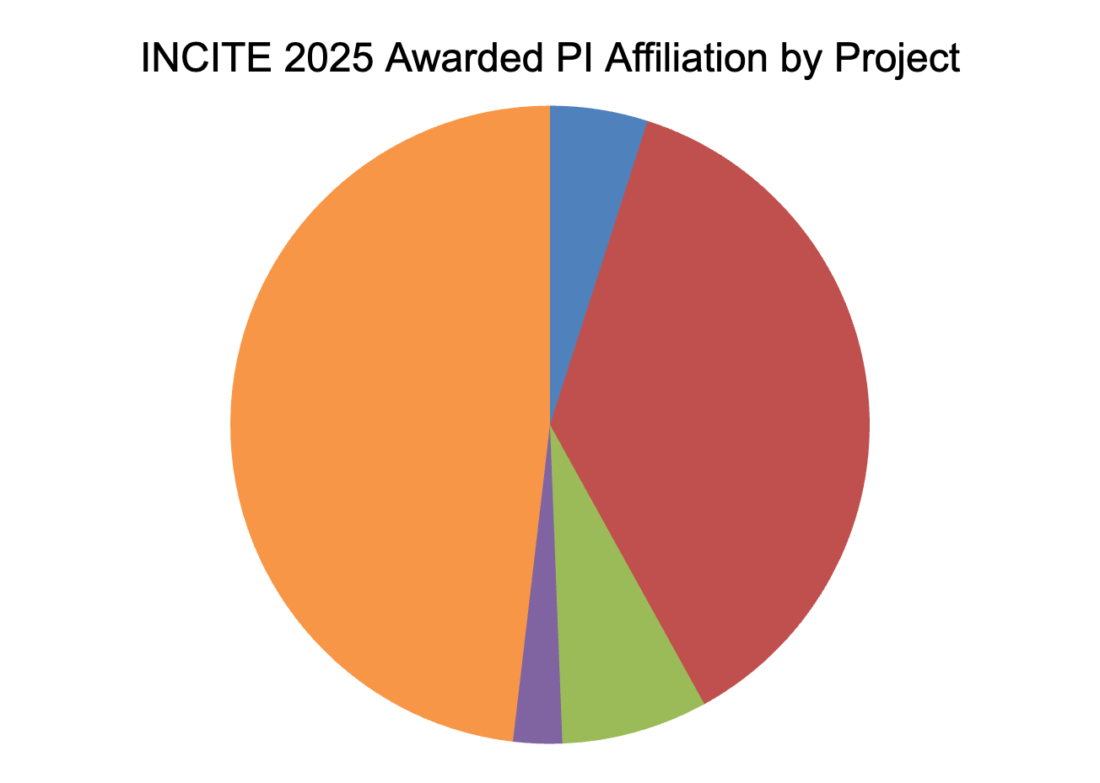
2025 INCITE Award Summary
Call for proposals closed June 14, 2024
60% of allocable time on the LCF production resources was awarded for CY 2025
108 peer reviewers from around the world
Submitted: 146 proposals (110 new, 36 renewal)
Awarded: 81 projects (45 new, 36 renewal)
41% of nonrenewal submittals were accepted
92% of proposals were meritorious
Foreign, 4.9%
Academia, 48%
Government, 37%
Non-Profit, 2.5%
Industry, 7.4%
 | Requested | Oversubscribed
Frontier | 86M | ~2.4x
Aurora | 48M | ~2.4x
Polaris | 12M | ~6.2x
Contact information
Katherine M. Riley, INCITE Manager
INCITE@DOEleadershipcomputing.org
Notes:
92 Reviewers

Slide 19
2025 Award Statistics
 | Frontier | Aurora | Polaris
Number of projects* | 55 | 34 | 20
Average Project | 695,900 | 665,800 | 130,000
Median Project | 750,000 | 550,000 | 200,000
Total Awards (node-hrs in CY2025) | 38,275,000 | 22,640,000 | 2,600,000
All reported in node-hours native to each resource
Total of INCITE projects : 81
Frontier, Aurora, Polaris : 4
Frontier, Aurora : 12
Frontier, Polaris: 3
Aurora, Polaris : 5
Notes:
Aurora 6

Slide 20
2025 Early Career Summary
Requested Early Career | Frontier | Aurora | Polaris
Total number early career applicants | 26 | 10 | 14
Percentage of Total Time Requested | 19% | 34% | 31%
Awarded Early Career | Frontier | Aurora | Polaris
Awarded number early career projects | 9 | 5 | 2
Percentage of Allocated Time | 16% | 8.5% | 9.6%
13% of 2025 INCITE to Early Career
Total of 13 Early Career INCITE Awards
37 total Early Career Applicants, out of 146 applicants
93% (29) Early Career Proposals were rated High or Mid-Meritorious (61% in 2024, 95% in 2023, 88% in 2022)
Early Career PIs wrote good proposals and were highly competitive
Panelists were encouraged to only assess proposals based on their merit – not to promote an early career proposal

Slide 21
2025 INCITE Science Panels
103 science experts
Diverse panels of reviewers including Society Fellows (AAAS, APS, IEEE, etc.), NSF or DOE Early Career scientists, Laboratory Fellows, National Academy members, Department Chairs or Full Professors
Significant carryover from year to year to promote continuity
When appropriate, proposals may also be assessed by a separate Data and AI Panel

Slide 22
New Early Career Path
TIPS
Why?
INCITE looks to support and encourage the next generation of researchers by committing 10% of allocatable hours
Who can apply to the Early Career Path?
Researchers less than 10 years out from their PhD who need LCF-level capabilities to advance their overall research plan, and who have not been a previous INCITE PI.
How to apply to the Early Career Path?
The option to self-identify as Early Career will be available on the INCITE 2026 application.
Will it increase my chances of an award?
If you qualify, it could. Overall, projects must still be meritorious in the peer review and computationally ready.
Do examine the Frequently Asked Questions for these and other topics.
(#20 - #23)

Slide 23
INCITE HPC Resources 1Y, 2Y and 3Y proposals
Year 1
Year 2
Year 3
LCF
2026
2027
2028
Frontier Cray/HPE
Frontier Cray/HPE
Frontier Cray/HPE
Polaris
HPE
Aurora Intel-HPE
Aurora Intel-HPE
Aurora Intel-HPE
Notes:
From Dima: “Rule of thumb” for Frontier is 3-4 million Summit-equivalent node-hours.
FAQ from Webinar #1: Andreas Kronfeld
Do you have advice on constructing a 3-year-plan with Frontier and Aurora?
The remarks above suggest treating Frontier in year 2 as “much more Summit”: correct?
What about Aurora?
FAQ from Webinar #1: Andreas Kronfeld
Also, should proposals for Frontier and/or Aurora include a contingency plan if one or the other is delayed?

Slide 24
Estimating Time on LCF Resources
Best Practice: Estimates based on running on resource of interest
Polaris and Frontier are currently available
Request a DD at the appropriate center(s)
Perform scaling and timings on a representative problem
Alternative: Using a similar resource
Perform timings on a resource as similar as possible
Frontier - Use an AMD GPU machine (ideally MI250X), otherwise a comparable GPU machine
Polaris - Use an NVIDIA GPU machine (ideally A100), otherwise a comparable GPU machine
Aurora - Use a comparable GPU machine or Aurora data if you have it (see next slide)
Perform timings on the closest node architecture and scaling on an appropriate sized GPU resource
Estimate performance on the targeted machine(s) using publicly available information and include the appropriate details in the proposal
300-800 K
Summit
IBM/NVIDIA
2021
Notes:
From Dima: “Rule of thumb” for Frontier is 3-4 million Summit-equivalent node-hours.
Ask for Summit Image from here: https://en.wikichip.org/w/images/3/37/ornl-summit-historical-roadmap.png
https://i.imgur.com/Mb7D8qi.png
FAQ from Webinar #1: van Oleynik
It would still be useful to get an idea for reasonable node-hour number per year for both Frontier and Aurora to request.

Slide 25
Estimating Time on LCF Resources
All requests are in Native Node Hours for each resource
Conversion factors are not provided for Frontier/Polaris
Aurora
We suggest using a 2:1 factor for converting from Polaris node hours to Aurora node hours
We suggest using a 1:1 factor for converting from Frontier node hours to Aurora node hours
PIs from ESP or ECP projects who have run on Aurora, or pre-Aurora hardware should indicate that in the proposal, and specify the programming model used.
Awarded hours are not transferable between resources
All resources require GPU capabilities and performance data should be provided based on measured GPU performance
Questions: Contact the center(s) or Program Manager
300-800 K
Summit
IBM/NVIDIA
Notes:
From Dima: “Rule of thumb” for Frontier is 3-4 million Summit-equivalent node-hours.
Ask for Summit Image from here: https://en.wikichip.org/w/images/3/37/ornl-summit-historical-roadmap.png
https://i.imgur.com/Mb7D8qi.png
FAQ from Webinar #1: van Oleynik
It would still be useful to get an idea for reasonable node-hour number per year for both Frontier and Aurora to request.

Slide 26
OLCF Resources - Frontier
Frontier Specs
Peak Performance | ≥ 2EF DP peak
Node | 1 HPC and AI Optimized AMD EPYC CPU (64-cores) 4 Purpose Built AMD Instinct MI250X GPUs, 2 GCDs / GPU
Memory | 512 GB DDR4 64 GB HBM Memory/GCD, 512 GB HBM per node
Number of Nodes | 9,858
CPU-GPU Interconnect | AMD Infinity Fabric Coherent memory across the node
System Interconnect | 4x Slingshot NICs providing 100 GB/s network bandwidth. Slingshot dragonfly network provides adaptive routing, congestion management and quality of service.
Storage | 700 PB, Lustre center-wide file system + 11 PB Flash
Frontier is a HPE Cray EX with a theoretical peak double-precision performance of approximately 2 exaflops. It has a total of 9,858 AMD compute nodes.
Each Frontier compute node consists of a single 64-core AMD 3rd Gen EPYC CPU and 512 GB of DDR4 memory. Each node also contains [4x] AMD MI250X, each with 2 Graphics Compute Dies (GCDs) for a total of 8 GCDs per node. Each GCD has 64 GB of high-bandwidth memory (HBM2E) for a total of 512 GB of HBM memory per node.
https://www.olcf.ornl.gov/frontier
https://docs.olcf.ornl.gov/systems/frontier_user_guide.html

Slide 27
ALCF Resources - Polaris
Polaris Specs
Platform | HPE Apollo 6500 Gen 10+
System Peak | 44 PF DP
Peak Power | 1.8 MW
Total System Memory | 280 TB CPU DDR4 + 87.5 TB GPU HBM2
System Memory Type | DDR, HBM
Node Performance | 78 TF DP
Node Processors | (1) AMD EPYC “Milan” 7543P CPU (4) NVIDIA HGX A100 GPUs
System Size (nodes) | 560
Interconnect | HPE Slingshot 11
Polaris is a hybrid CPU/GPU leading-edge testbed system that will give scientists and application developers a platform to test and optimize codes for Aurora
Polaris is available to New and Renewal for 2026.
https://www.alcf.anl.gov/polaris

Slide 29
Key Questions to Ask Yourself
Is both the scale of the runs and the time demands of the problem of LCF scale?
Yes, I can’t get the amount of time I need anywhere else.
Yes, my applications are too large to run on other systems.
Do you need specific LCF hardware or systems?
Yes, the very large memory and I/O available here are necessary for my work.
Yes, my application requires mixed/reduced precision accelerator hardware.
Do you have the people ready to do this work?
No, I’m waiting to hire a postdoc.
Yes, I have commitments from the major participants.

Slide 30
Key Questions to Ask Yourself (cont.)
Note: Some of these characteristics are negotiable, so make sure to discuss atypical requirements with the centers.
Do you have large data/AI needs?
Yes, my data-intensive needs require the LCF resources.
Do you have a workflow solution?
Do you have a post-processing strategy?
Do you use ensemble runs and need LCF resources?
My ensembles can run under the direction of a large job or workflow manager, with I/O scaling on a parallel file system -> possibly yes
My ensemble expects to run millions of serial batch jobs on nodes with local disk available -> probably no
Do you understand the life cycle of your data?

Slide 31
Getting Started: Know Your Audience
TIPS
Don’t assume that your audience is familiar with your work through other review programs (ex. funding agencies). INCITE is very broad in scope and you may be competing against a diverse set of proposals.
Do look at the reviewer questionnaires, posted on the INCITE Call for Proposals site
Remember, INCITE is very broad in scope
Reviewers are computational-science-savvy senior scientists and engineers drawn around the world from national labs, universities, and industry
They will be assessing potential impact of this work versus other proposals submitted
Notes:
KGF: possibly pause here for questions?
Emphasize

Slide 32
Proposal Form: Outline
0 | Project title
1 | Principal investigator and co-principal investigators
2 | Project information (Research category, Project Summary)
3 | INCITE allocation request; Other funding/computing support
4 | Project narrative, other materials
 | (A) Executive summary (1 page)
 | (B) Project narrative including impact of the work, objectives, benchmarking (15 pages)
 | (C) Personnel justification & management plan
 | (D) Milestone table
 | (E) Publications resulting from INCITE Awards
 | (F) PI / Co-I Biographical Sketches
5 | Software applications and dependent packages
6 | Wrap-up Questions (Proprietary and sensitive information, Export Control)
7 | Outreach and suggested reviewers

Slide 33
Narrative: Impact of the Work
TIPS
Do give a compelling picture of the impact of this work, both in the context of your field and, where appropriate, beyond.
Do explain why this work cannot be done elsewhere. Reviewers scrutinize whether another allocation program may be a better fit.
This is the principal determinant of a successful submittal!
What is the scientific challenge and its significance?
Impact of a successful computational campaign — the big picture
Reasons this work needs to be done now, on the resources requested

Slide 34
Narrative: Objectives and Milestones
TIPS
Do clearly articulate your project’s milestones for each year. Reviewers have downgraded proposals that don’t show that the PI has a well thought out plan for using the allocation and LCF resources.
Do bear in mind that the average INCITE award of time for a single project is equivalent to several million dollars.
Successful proposals must also very clearly
Describe the approach to solving the problem, its challenging aspects, preliminary results
Tie the resources requested to your key objectives, key simulations, and project milestones in your milestone table

Slide 35
Narrative: Computational Approach Provide the basic foundation
Describe the underlying formulation
Don’t assume reviewers know all the codes
Do show that the code you plan to employ is the correct tool for your research plan
Do explain the differences if you plan to use a private version of a well-known code
List programming languages, libraries and tools used
Check that what you need is available on the system
List required software (noting that the team may need to build some software)

Slide 36
Narrative: Computational Approach Provide the basic foundation
Data Management
Requirements for bringing input data, storage, and movement of data
Describe how long data needs to remain on spinning disk and archive and how those times were determined
Describe the long term use of data (e.g. publicly available)
Describe tools or infrastructure required to support data needs
Data and AI, and Workflows
Describe any AI, analytics and viz that are part of the project, and how you intend for that work to be done
If appropriate, describe workflow tools that will be used to facilitate the volume of work

Slide 37
Narrative: Computational and/or Data Intensive Campaign
TIPS
Do clearly emphasize the relationship between the proposed runs and the major milestones. This helps the Awards Committee maximize your milestones, if they can’t grant the full award requested.
Describe the shape of runs you plan with your allocation
L exploratory runs using M nodes for N hours
X big runs using Y nodes for Z hours
P analysis runs using Q nodes for R hours
Big runs often have big output and/or big I/O
Show you can deal with it and understand the bottlenecks
Understand the size of results, where you will analyze them, and how you will get the data there
The details are important!

Slide 38
Code Performance Overview Performance data should support the required scale
TIPS
Do provide performance data in the requested format.
Do provide performance of the scaling baseline, not just scaling efficiency
Use similar problems to what you will be running
Show that you can get to the range of nodes required
Demonstrate efficient use of nodes and node-specific hardware (e.g. GPUs on Frontier or Aurora)
Best to run on the same machine, but similar size runs on other machines can be useful
Be clear about the number of nodes, MPI ranks, threads, and GPUs being used in runs
Include production-style I/O in benchmarks (checkpoint/restart, analysis)
Describe how you will address any scaling deficiencies

Slide 39
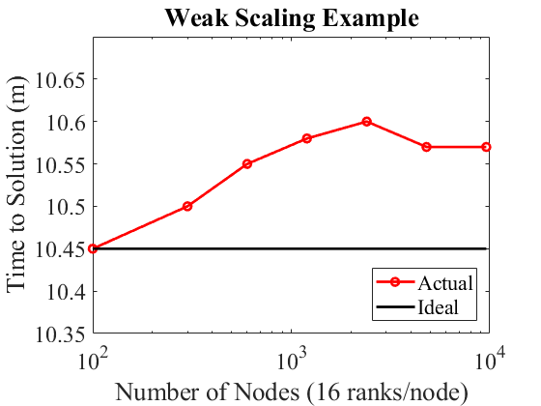
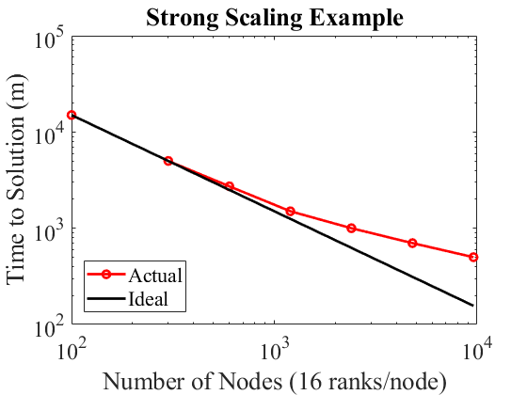
Parallel Performance: Direct Evidence
WEAK SCALING, which is defined as how the solution time varies with the number of nodes for a fixed problem size per node: | STRONG SCALING, which is defined as how the solution time varies with the number of nodes for a fixed total problem size:
Increase problem size as resources are increased | Increase resources (nodes) while doing the same computation
Pick the approach(es) relevant to your work and show results
Note: the axes could be samples per second or throughput versus number of nodes. For Data and AI applications, show the scaling (e.g., for convergence) dependence on factors such as hyperparameters and discuss scientific impact.

Slide 40
More About our Ensemble Policy “Can I meet the computationally intensive criterion by loosely coupling my jobs?”
TIPS
Do examine the Frequently Asked Questions (#33)
Possibly “yes”
If you require large numbers of discrete or loosely coupled simulations where time-to-solution is an untenable pacing issue, and
If a software workflow solution (e.g., pre- and post-processing scripts that automate run management and analysis) is provided to facilitate this volume of work.
Probably “no”
If by decoupling the simulations the work could be effectively carried out on a smaller resource within a reasonable time-to-solution.
https://www.doeleadershipcomputing.org/incite-faqs

Slide 41
Data and AI Applications In addition to traditional computationally intensive simulation campaigns, INCITE encourages Data and AI projects.
TIPS
Strong aspects of scalable data processing and/or AI.
Example areas
Machine and/or Deep learning
Data-intensive computing
Experimental/observational/simulation data analytics
Complex and interactive workflows
Streaming/real-time data analysis
Statistical methods
Graph analytics
Uncertainty quantification

Slide 42
Data and AI Applications In addition to traditional computationally intensive simulation campaigns, INCITE encourages Data and AI projects.
TIPS
Do examine the Frequently Asked Questions for these and other topics.
(#34 & #35)
Successful proposals must
Clearly articulate the objectives and dependencies of the end-to-end research campaign e.g. training data requirements and generation; deep learning/data-driven model selection and validation; model embedding to augment simulations etc.
List the application requirements, including databases, machine learning/deep learning frameworks, workflow software, containers, etc.
Demonstrate that the software can run efficiently on the resources requested.
Proposals which target the convergence or interleaving of simulation, data analytics and AI are also encouraged
https://www.doeleadershipcomputing.org/incite-faqs

Slide 43
Data Usage (All Projects)
List your total online and offline (archive) storage for the project
For each milestone list the total online and offline storage
Include the estimated duration the data is need
For large data projects include a discussion of the data requirements
storage amount
duration
brief description of the type of data
If you have any special or unusual requirements please be sure to describe them in your proposal
Make sure you read and are familiar with the center(s) data policies

Slide 44
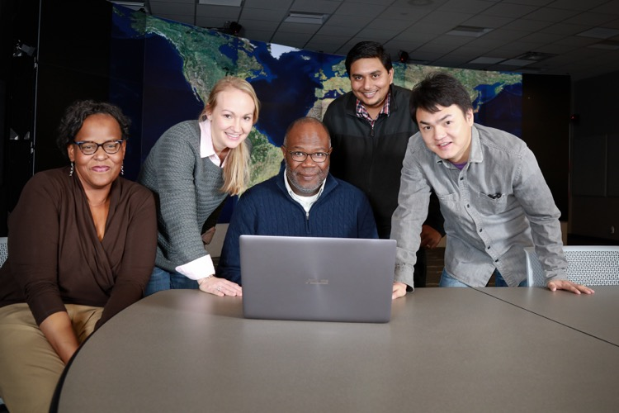
Narrative: Development Work –
Developmental Work
Describe any additional development required to execute any of your milestones. Identify any dependencies and how you will validate.
Estimate the computational resources required for this work and when it will be completed.

Slide 45
Narrative: Management Plan
TIPS
Do include in “Personnel Justification” a brief description of the role of each team member. Although not a requirement, proposals with application developers or clear connections to development teams are favorably viewed by readiness reviewers.
Experience and credibility
List the scientific and technical members and their experience as related to the proposed scientific or technical goals
Successful proposal teams demonstrate a clear understanding of petascale computing and can optimally use these resources to accomplish the stated scientific/technical goals
Team members can be part of different proposals
Transparent use of time
Projects involving multiple teams or different thrust areas should clearly state how the allocation will be distributed and managed

Slide 46
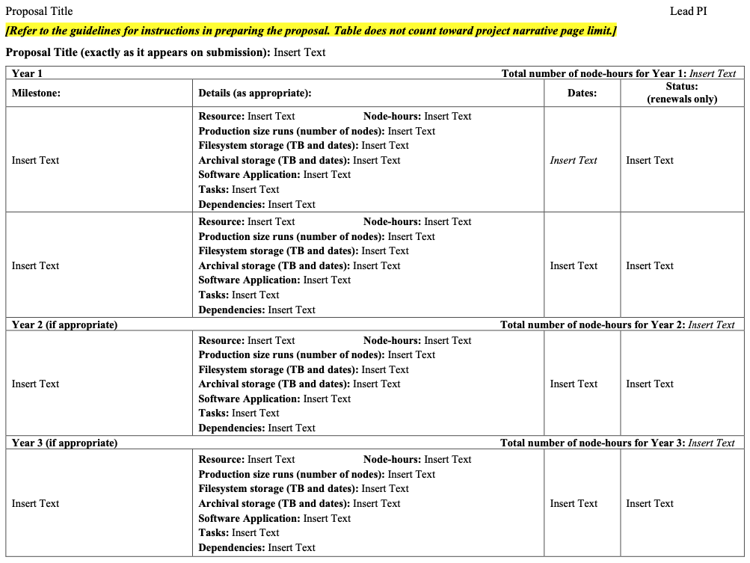
Narrative: Milestone Table
Note:
The Milestone Table is a required document. Proposals without it will not be accepted for review.
Clearly state the scientific and technical milestones for each year of your proposed work.
Milestones should be appropriate for the size and duration of the requested award. Future modifications in scope will be tracked through this table.
As appropriate, details to provide for each milestone:
Computing resource and allocation request (node-hours).
Production size runs (number of nodes).
Filesystem and archival storage, and duration.
Software application employed.
Summary of the computational tasks (e.g., computational runs, data analysis, data reduction).
Dependencies on or between other milestones.
Expected start, target completion date and status.

Slide 47
Narrative: INCITE Publications
Publications resulting from INCITE awards
To show impact of the INCITE program, we ask authors to list the publications, including DOIs when available, resulting from previous INCITE awards to this project team for work related to the proposal under consideration.
All publications that were enabled by an INCITE project should include an acknowledgement of the INCITE program and/or the LCF.
Include only publications with INCITE acknowledgements.

Slide 48
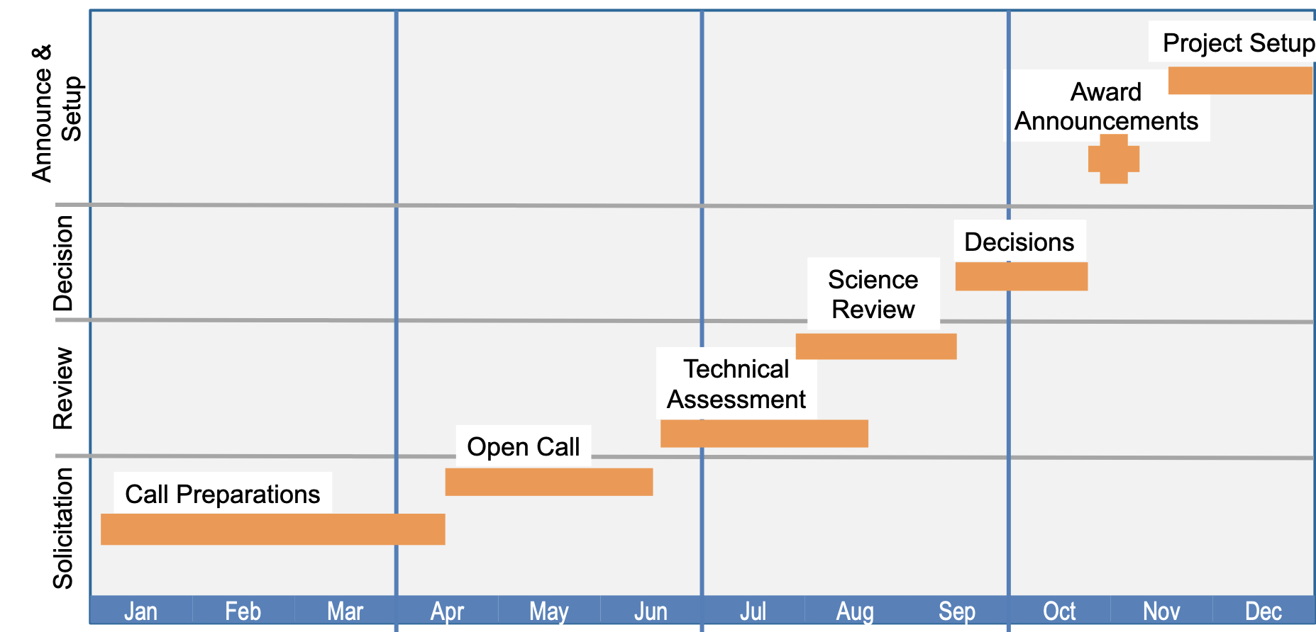
INCITE Annual Timeline

Slide 49
Are You Ready to Apply Now?
TIPS
Do make the benchmark examples as similar to your production runs as possible, or, make it clear why another benchmark example is valid for your proposed work.
Port your code before submitting the proposal
Check to see if someone else has already ported it
Request a startup account if needed (see next slide)
Provide compelling benchmark data
Prove application scalability in your proposal
Run example cases at proposed production scale
If you cannot show proof of runs at the proposed production scale, then provide a very tight story about how you will succeed

Slide 50
Request a Start-up Account Now
Director’s Discretionary Proposals considered year-round
Awards up to thousands of node-hours
Allocated by LCF center directors
Director’s Discretionary (DD) requests can be submitted anytime
DD may be used for porting, tuning, scaling in preparation for an INCITE submittal
Submit applications at least 2 months before INCITE Call for Proposals closes
60% INCITE
30% ASCR Leadership Computing Challenge, ECP
Argonne DD Program: https://www.alcf.anl.gov/science/directors-discretionary-allocation-program
Oak Ridge DD Program: https://my.olcf.ornl.gov/project-application-new

Slide 51
Proposal Form: Final Check
0 | Project title
1 | Principal investigator and co-principal investigators
2 | Project information (Research category, Project Summary)
3 | INCITE allocation request; Other funding/computing support
4 | Project narrative, other materials
 | (A) Executive summary (1 page)
 | (B) Project narrative including impact of the work, objectives, benchmarking (15 pages)
 | (C) Personnel justification & management plan
 | (D) Milestone table
 | (E) Publications resulting from INCITE Awards
 | (F) PI / Co-I Biographical Sketches
5 | Software applications and dependent packages
6 | Wrap-up Questions (Proprietary and sensitive information, Export Control)
7 | Outreach and suggested reviewers

Slide 52
Q&A
Open discussion on what authors should include in their proposal
Reminder: The INCITE program has significantly changed its proposal submission site. Please allow extra time to create an account on this site and submit your proposal.

Slide 53
Submitting Your Proposal or Renewal
You may save your proposal at any time without having the entire form complete
Required fields must be completed for the form to be successfully submitted
An incomplete form may be saved for later revisions
After submitting your proposal, you will be able to edit and resubmit it up until the submission deadline
Submit

Slide 54
INCITE Awards Committee Decisions
The INCITE Awards Committee is comprised of the LCF center directors, INCITE program manager, LCF directors of science and senior management.
The committee identifies the top-ranked proposals by a) peer-review panel ratings, rankings, and reports; and b) additional considerations, such as the desire to promote use of HPC resources by underrepresented communities.
Technical assessment review is used to identify whether the top-ranked proposals are “ready” for the requested system.

Slide 55
INCITE Awards Committee Decisions
A balance is struck to ensure
each awarded project has sufficient allocation to enable all or part of the proposed scientific or technical achievements
a robust support model for each INCITE project
When the centers are oversubscribed, each potential project is assessed to determine the amount of time that may be awarded to allow the researchers to accomplish significant scientific goals.
Requests for appeals can be submitted to the INCITE manager or LCF center directors. If an error has occurred in the decision-making process (e.g. procedural, clerical), consideration is given by the INCITE management and an award may be granted. Assessment of the relative scientific merit is not considered in appeals.

Slide 56
2026 INCITE Award Announcements
Awards will be announced by INCITE Manager, Katherine Riley, in November 2025
Welcome and startup information from centers
Agreements to sign: Start this process as soon as possible!
Getting started materials: Work closely with the center
Centers provide expert-to-expert assistance to help you get the most from your allocation
Scientific “Liaisons” (OLCF) and “Catalysts” (ALCF)

Slide 57
PI Responsibilities
Provide quarterly status updates (on supplied template)
Milestone reports
Publications, awards, journal covers, presentations, etc., related to the work
Provide highlights on significant science/engineering accomplishments as they occur
Submit annual renewal request
Complete annual surveys
Encourage your team to be good citizens on the computers
Use the resources for the proposed work
Let us know your achievements and challenges

Slide 58
PI Responsibilities (cont.)
Encourage your team to attend the center’s user meeting
All INCITE users are expected to acknowledge the center and the program in publications resulting from their award:
An award of computer time was provided by the Innovative and Novel Computational Impact on Theory and Experiment (INCITE) program.
and either
This research used resources of the Oak Ridge Leadership Computing Facility located in the Oak Ridge National Laboratory, which is supported by the Office of Science of the Department of Energy under Contract DE-AC05-00OR22725.
This research used resources of the Argonne Leadership Computing Facility at Argonne National Laboratory, which is supported by the Office of Science of the U.S. Department of Energy under contract DE-AC02-06CH11357.

Slide 59
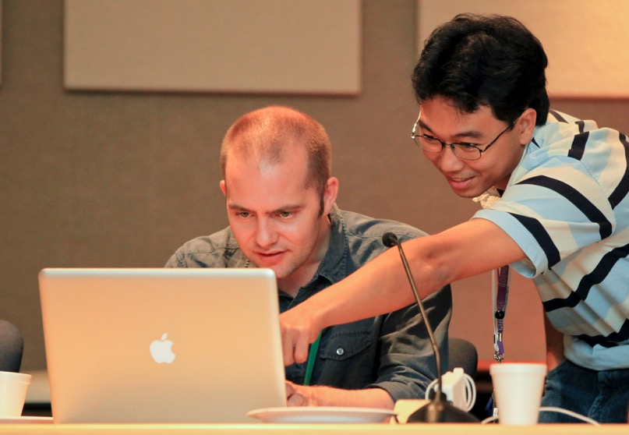
It is a Small World…
Let the science agency that funds your work know how significant the INCITE program and the Leadership Computing Facilities will be to your work
Contact us if you have questions; we want to hear from you

Slide 60
Contacts
For details about the INCITE program:
www.doeleadershipcomputing.org
INCITE@DOEleadershipcomputing.org
For details about the centers:
www.olcf.ornl.gov
help@olcf.ornl.gov, 865-241-6536
https://my.olcf.ornl.gov/project-application-new
www.alcf.anl.gov
support@alcf.anl.gov
https://www.alcf.anl.gov/science/directors-discretionary-allocation-program

